Slide 1
GraphQL Schema Stitching
WITH

Slide 2

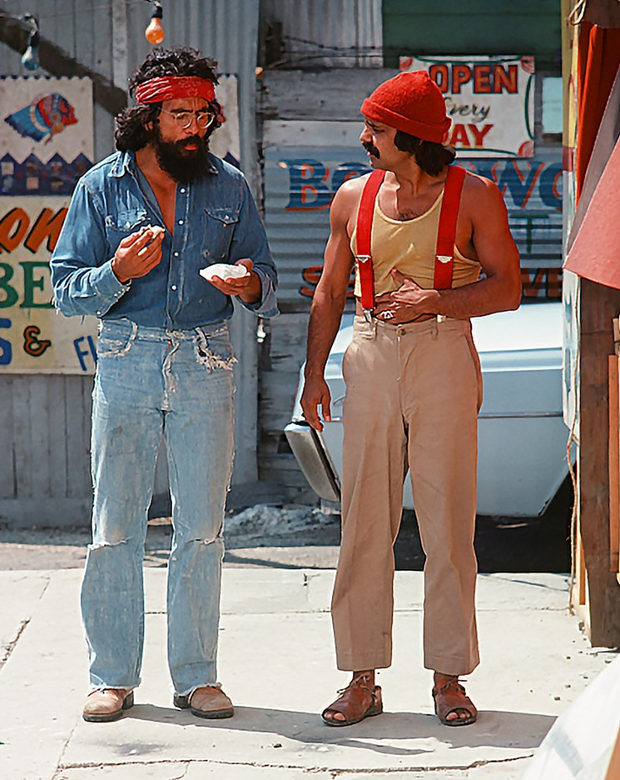
Who are we?

Slide 3

Who is this for?
Who is this for?

Slide 4
Principles
One Graph
One Endpoint
One Request
Federated Implementation

Slide 5
How can we do microservices with that?

Slide 6


Slide 7

What is schema stitching?

Slide 8
The capability to merge multiple GraphQL schemas into one schema.

Slide 9

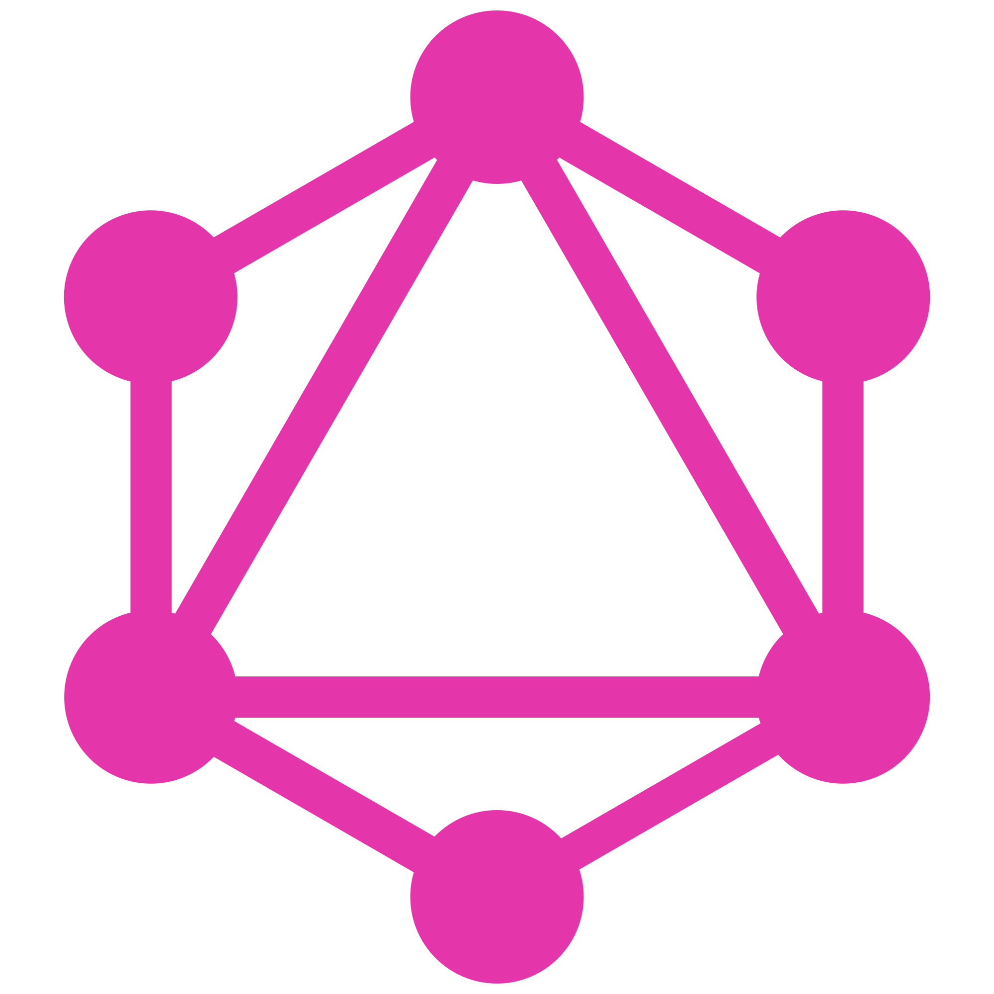
One GraphQL Query
query {
me {
messages {
# Hot Chocolate GraphQL
text
# Apollo Server
createdBy {
name
}
# Abritray REST Endpoint
views
likes
replies
}
}
}
Hot Chocolate Gateway
text
createdBy
views, likes, replies
{REST}
Apollo GraphQL
Hot Chocolate GraphQL
Arbitrary REST Endpoint
Raven DB
Mongo DB
SQL Server

Slide 10
Demo

Slide 11
Conclusion
Easy to use with minimal code in the gateway
Describe GraphQL with GraphQL
Merge multiple data source together
Adds complexity

Slide 12
Outlook

Slide 13
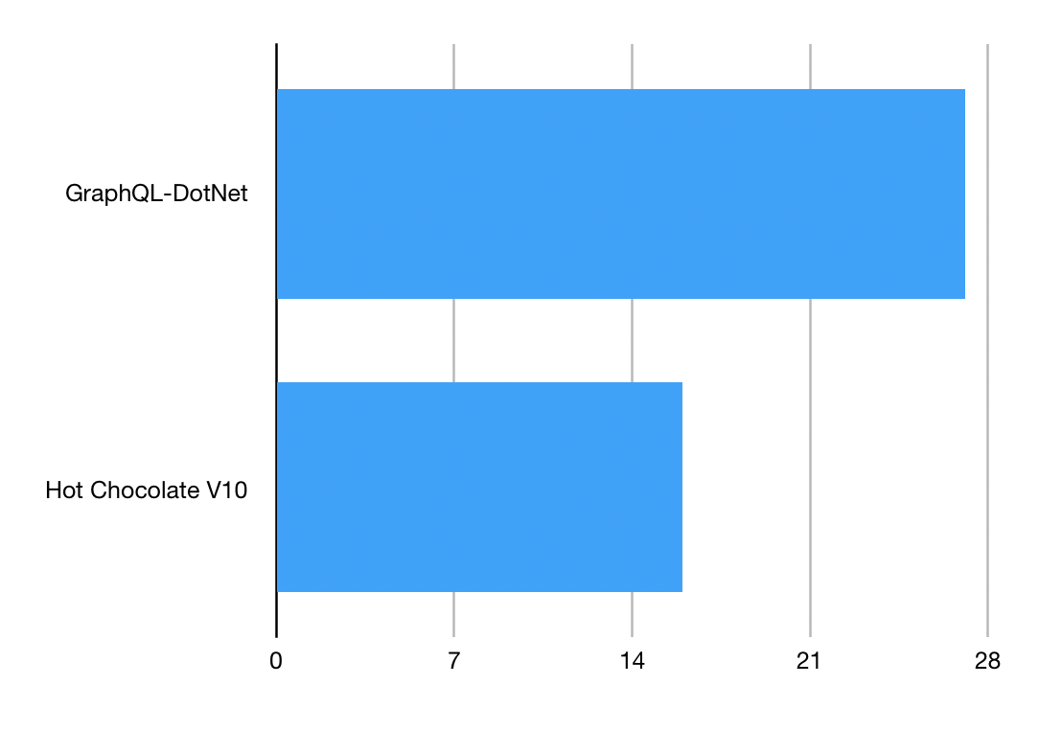
Speed:

Slide 14
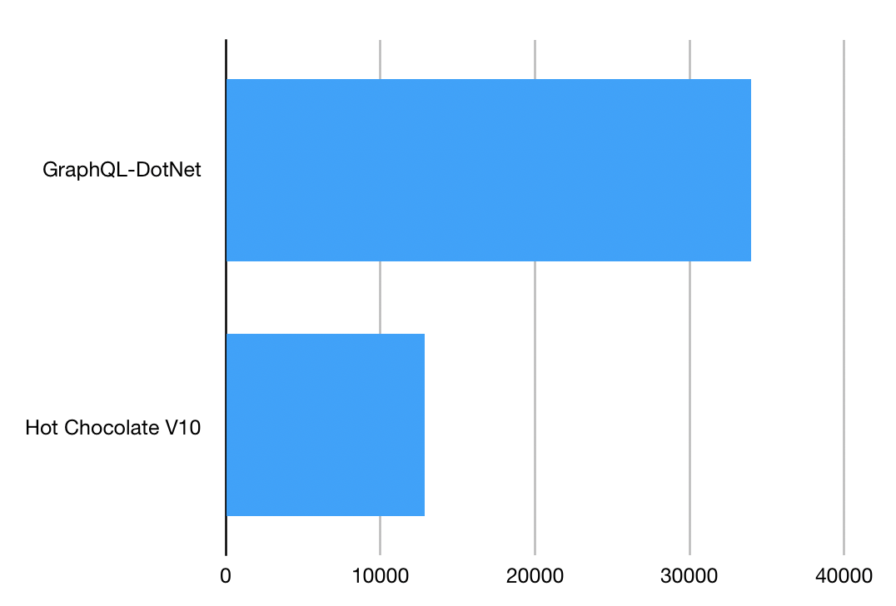
Memory:

Slide 15
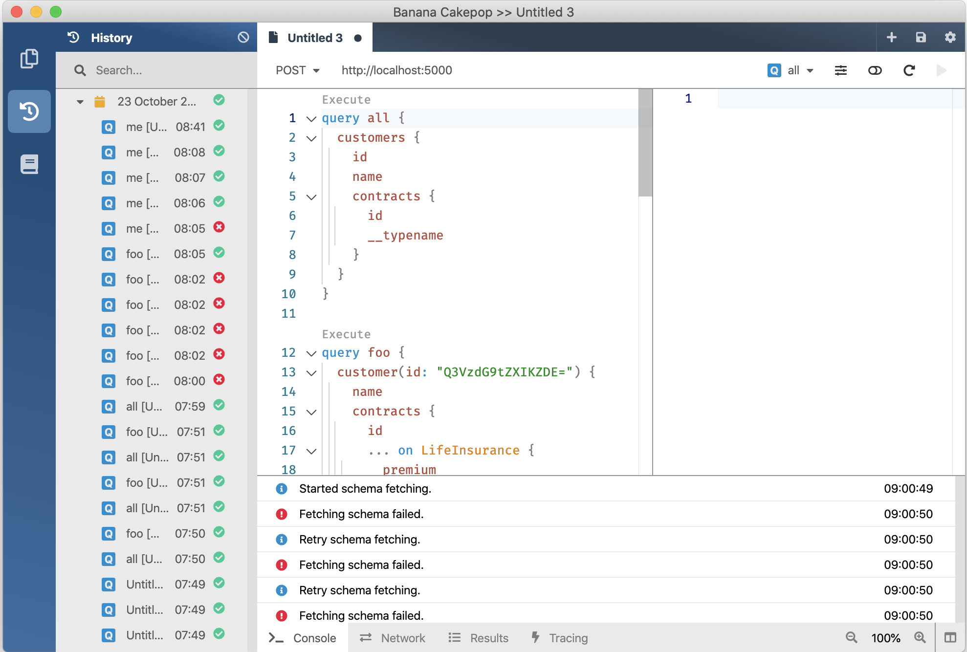
V10
GraphQL Gateway
V11 January 2020
V12 August 2020
GraphQL Client
GraphQL Server
Developer Tooling
Supports Blazor and Xamarin
Execution Plans @defer @stream
Schema Registry (Schema Change Tracking, CI Tools)
Automatic Database Mapping
GraphQL Analytics
Operations Manager (Execution Plan Store, Whitelisting, Client Registry)

Slide 16
Where do you find us?
https://hotchocolate.io
https://chillicream.com
https://github.com/ChilliCream/ApexVox2019
https://twitter.com/Chilli_Cream
https://github.com/ChilliCream

